Slide 1

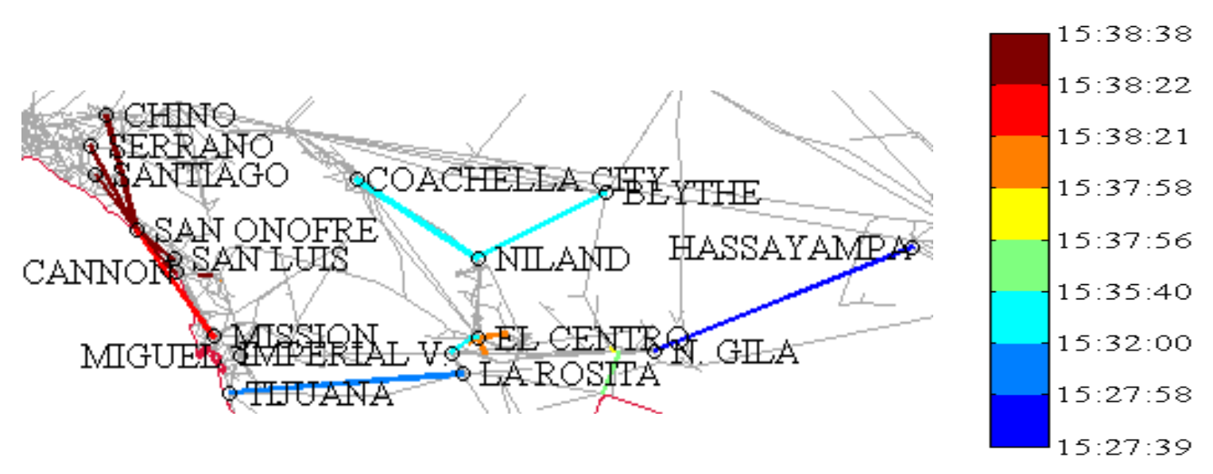
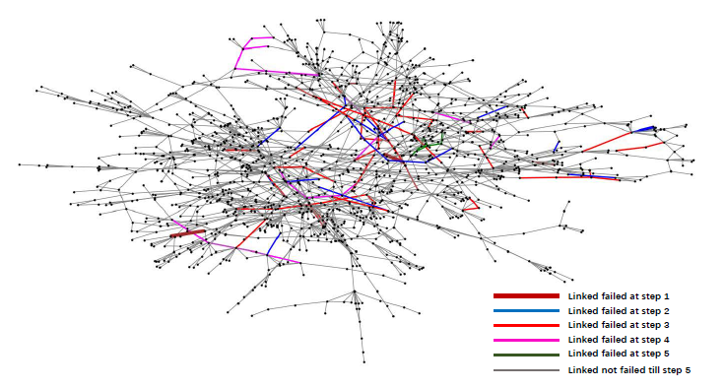

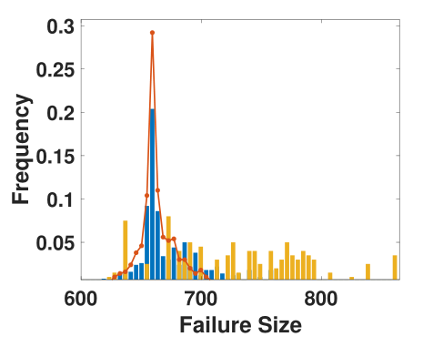
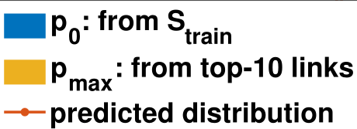
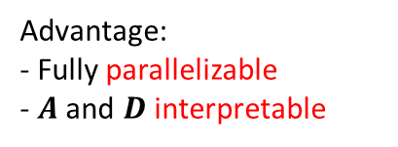
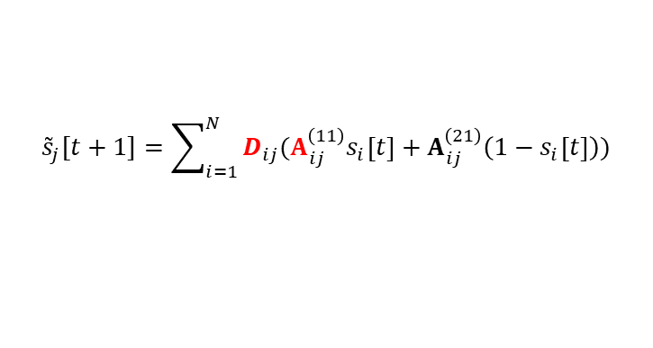
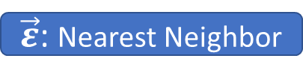



Research 1: Failure Cascade Prediction in Power Grids
Motivation
Influence Model
Large Blackout due to Failure Cascade
1
2
1
2
1
2
3
4
3
4
3
4
Pair-wise influence: $A_{14}=\left[\begin{matrix}0.9 & 0.1 \\ 0.2 & 0.8\end{matrix}\right]$
Influence Weight: $D_{12},D_{42}$
Modeling failure cascade:
$${\tilde{s}}_{j}[t+1]=\sum_{i=1}^{N}{D_{ij}(A_{ij}^{\left(11\right)}s_{i}\left[t\right]+A_{ij}^{\left(21\right)}\left(1−s_{i}\left[t\right]\right)})$$
$${\hat{s}}_{j}[t+1]=1\{{\tilde{s}}_{j}[t+1]≥ε_{j}\}$$
[ Parameters: $\{A, D, \vec{ε}\}$ ]
Learning Framework
Experiments
Metric | Result
Failure Size | <3% error
Final State | <9% error
Failure Time | <1.5 units
Time Cost | 1/872 of flow cal.
Q: Can we predict it in early stage?
$A$: Monte-Carlo
Contributions
1) Influence model to capture failure cascade
2) 3-step learning framework to learn the influence model
3) Evaluation on real systems over: failure size, final state, failure time, time cost, etc.
4) Critical component identification
$D$: Min. MSE ${\left\|s\left[t\right]−\tilde{s}\left[t\right]\right\|}^{2}$
IEEE1354-bus
$\vec{ε}$: Nearest Neighbor
Connection to Industry Research:
1) Prediction framework is promising to failure cascade in server communication networks.
2) ML experience in time series prediction over large datasets
Advantage:
- Fully parallelizable
- $A$ and $D$ interpretable
Top-10 Critical Components
X. Wu, D. Wu and E. Modiano, "Predicting Failure Cascades in Large Scale Power Systems via the Influence Model Framework," in IEEE Transactions on Power Systems, vol. 36, no. 5, pp. 4778-4790, Sept. 2021, doi: 10.1109/TPWRS.2021.3068409.
Notes:
撰写Introduction within 1 minute
This is my first work after coming to MIT. I focus on the large blackout in real life, which generally stems from the failure of very few components, for example power generators or transmission lines, and then cascade to large areas. We are interested in whether we can predict the failure cascade process once a power failure occurs, and if it can be done very rapidly, we may prevent from large blackout at the beginning. Specifically, we apply an influence model to capture the failure cascade process, and propose a 3-step learning framework to learn this model, and test its performance on large-scale power system with multiple accuracy and efficiency metrics. The advantage of this learning framework is that the whole process is parallelizable, and the parameters can be interpreted with physical meaning, for example they can also be used to identify the critical components whose failure will cause severe blackout. Moreover, this framework can be extended to predict cascading effect in communication networks as well, which may benefit control and protection under network overload.

Slide 2
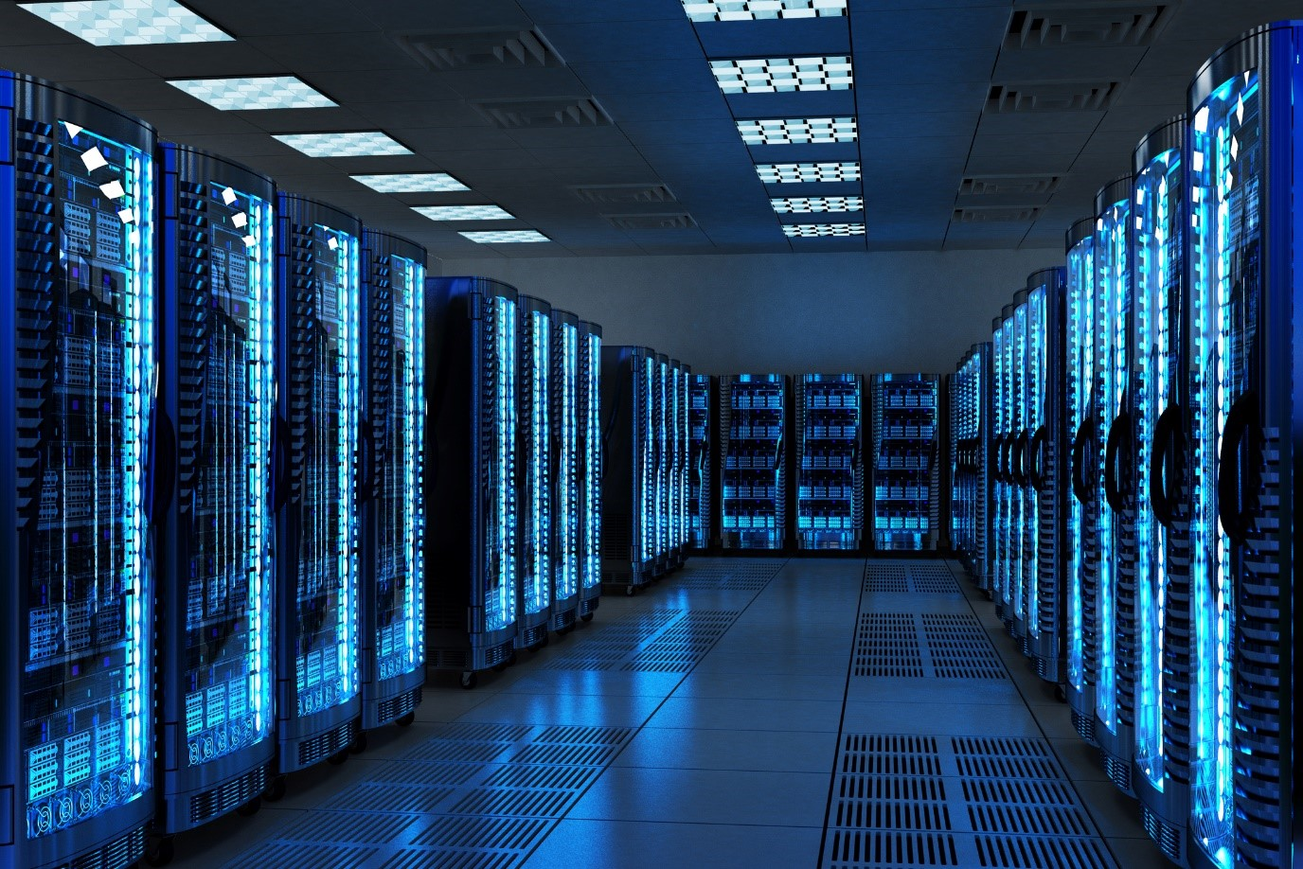
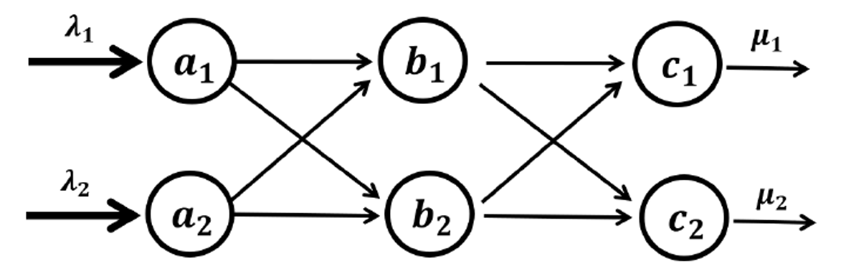
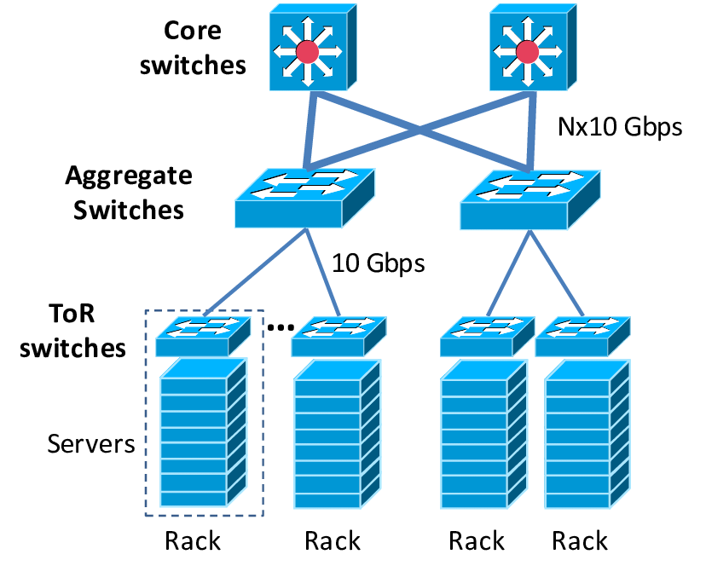
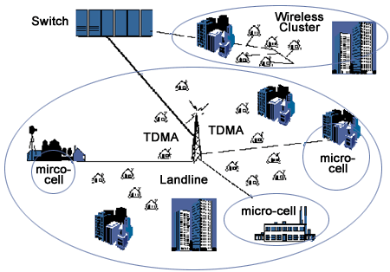
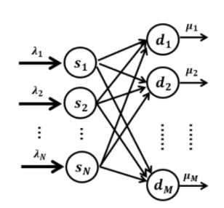
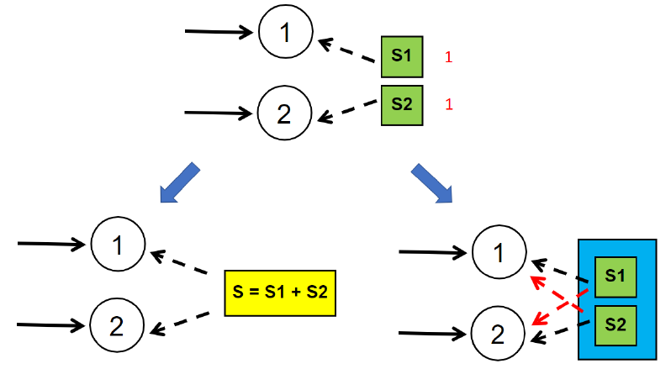


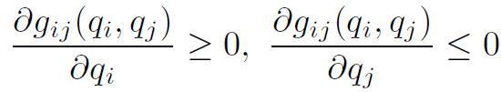



Research 2 (series): Performance Enhancement in Overloaded Networks
Motivation
(1) Latency
Prove & evaluate that
Setting max rates on all links is generally NOT optimal.
Properly setting smaller rates reduces latency & saves energy.
10% ↓ in avg. & 50% ↓ in max latency.
Set service rates to minimize queueing latency when network is overloaded:
- Extensive analysis over underloaded systems
Server Farm
?
?
?
- However, overloaded situation becomes more frequent in IoT but under unsystematic study & results
?
Datacenter
(2) Fairness
Ongoing
Balancing input loads when egress buffer is bounded:
- Study the risk of resource pooling failures on network performance, where the above results may be applied.
Mobile System
Communication infrastructure in Smart Grid; Cloud; HPC; Edge computing, etc.
Buffer sharing;
Power supply
Cloud server cluster; Power sharing
Contributions
Centralized
Distributed
1) Model queue dynamics by flow, which generalizes different network settings.
- overload/underload, shared/split buffer, etc.
2) Propose network policies that optimize QoS metrics: latency, fairness, throughput, under network overload.
(3) Stability
Connection to Industry Research:
- Optimization & algorithm design on network infrastructure: load balancing in VMs, job scheduling for ML tasks, resource allocation in cloud platform, etc.
A queue-based policy design criterion to stabilize the networks that generalizes a set of policies:
$$s$$
$$d$$
Two papers are published, and one is submitted.
Notes:
撰写Introduction within 1 minute
This series of works started after I obtained my master degree. The motivation of these works is that there is a lacking of study under network service performance enhancement in overload condition, which may be more frequent under future IoT. Specifically, we figure out that modeling the dynamics in a queue-flow manner by ordinary differential equation can help us analyze the performance under overload, and generalize different network settings, which is hard for the classical discrete queueing model. Based on this, we propose network policies to optimize latency, fairness, and throughput based on optimization theory and dynamical system analysis. We have found sth interesting and meaningful: for example setting maximum transmission rates among all links does not necessary minimize latency, and we provide a way to configure them to reduce latency and save energy for transmission. We also have some clear analytical result on improving fairness and throughput. In fact, now I am interested in studying the risk of resource pooling failures on these network performance, so the above result may be used in such practical problem in cloud computing, or resource allocation.

